Slide 1
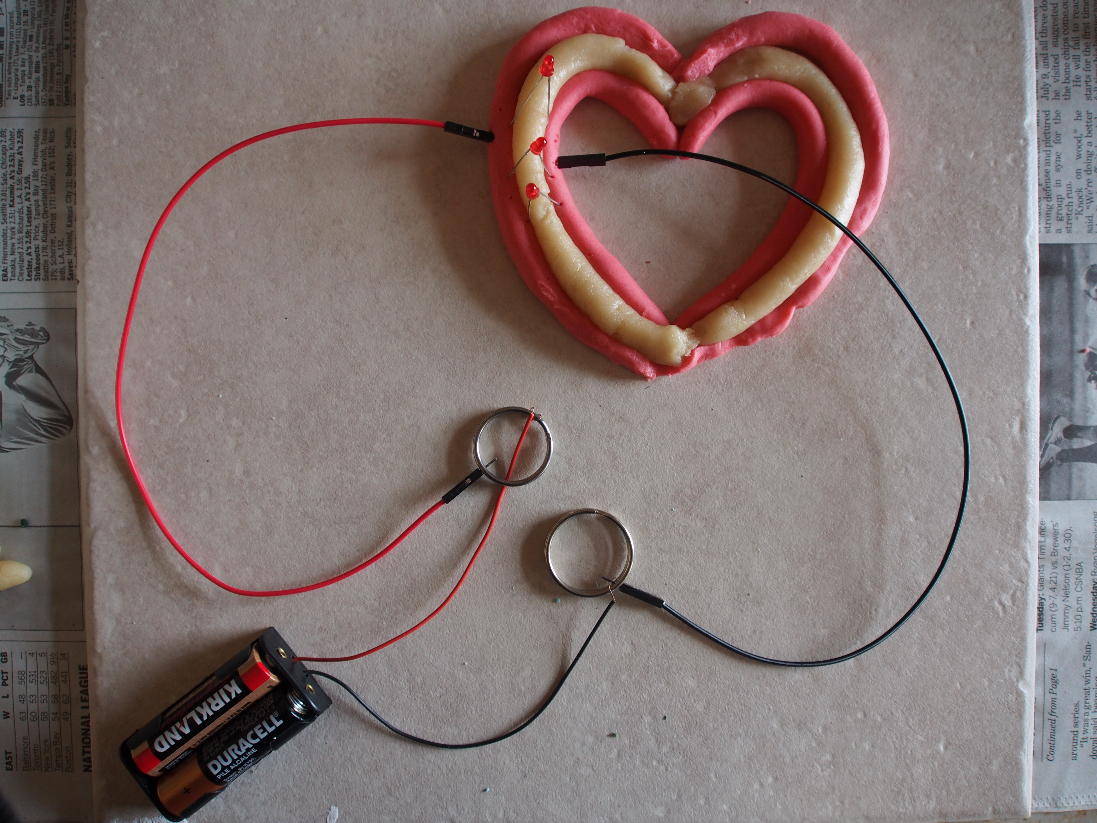
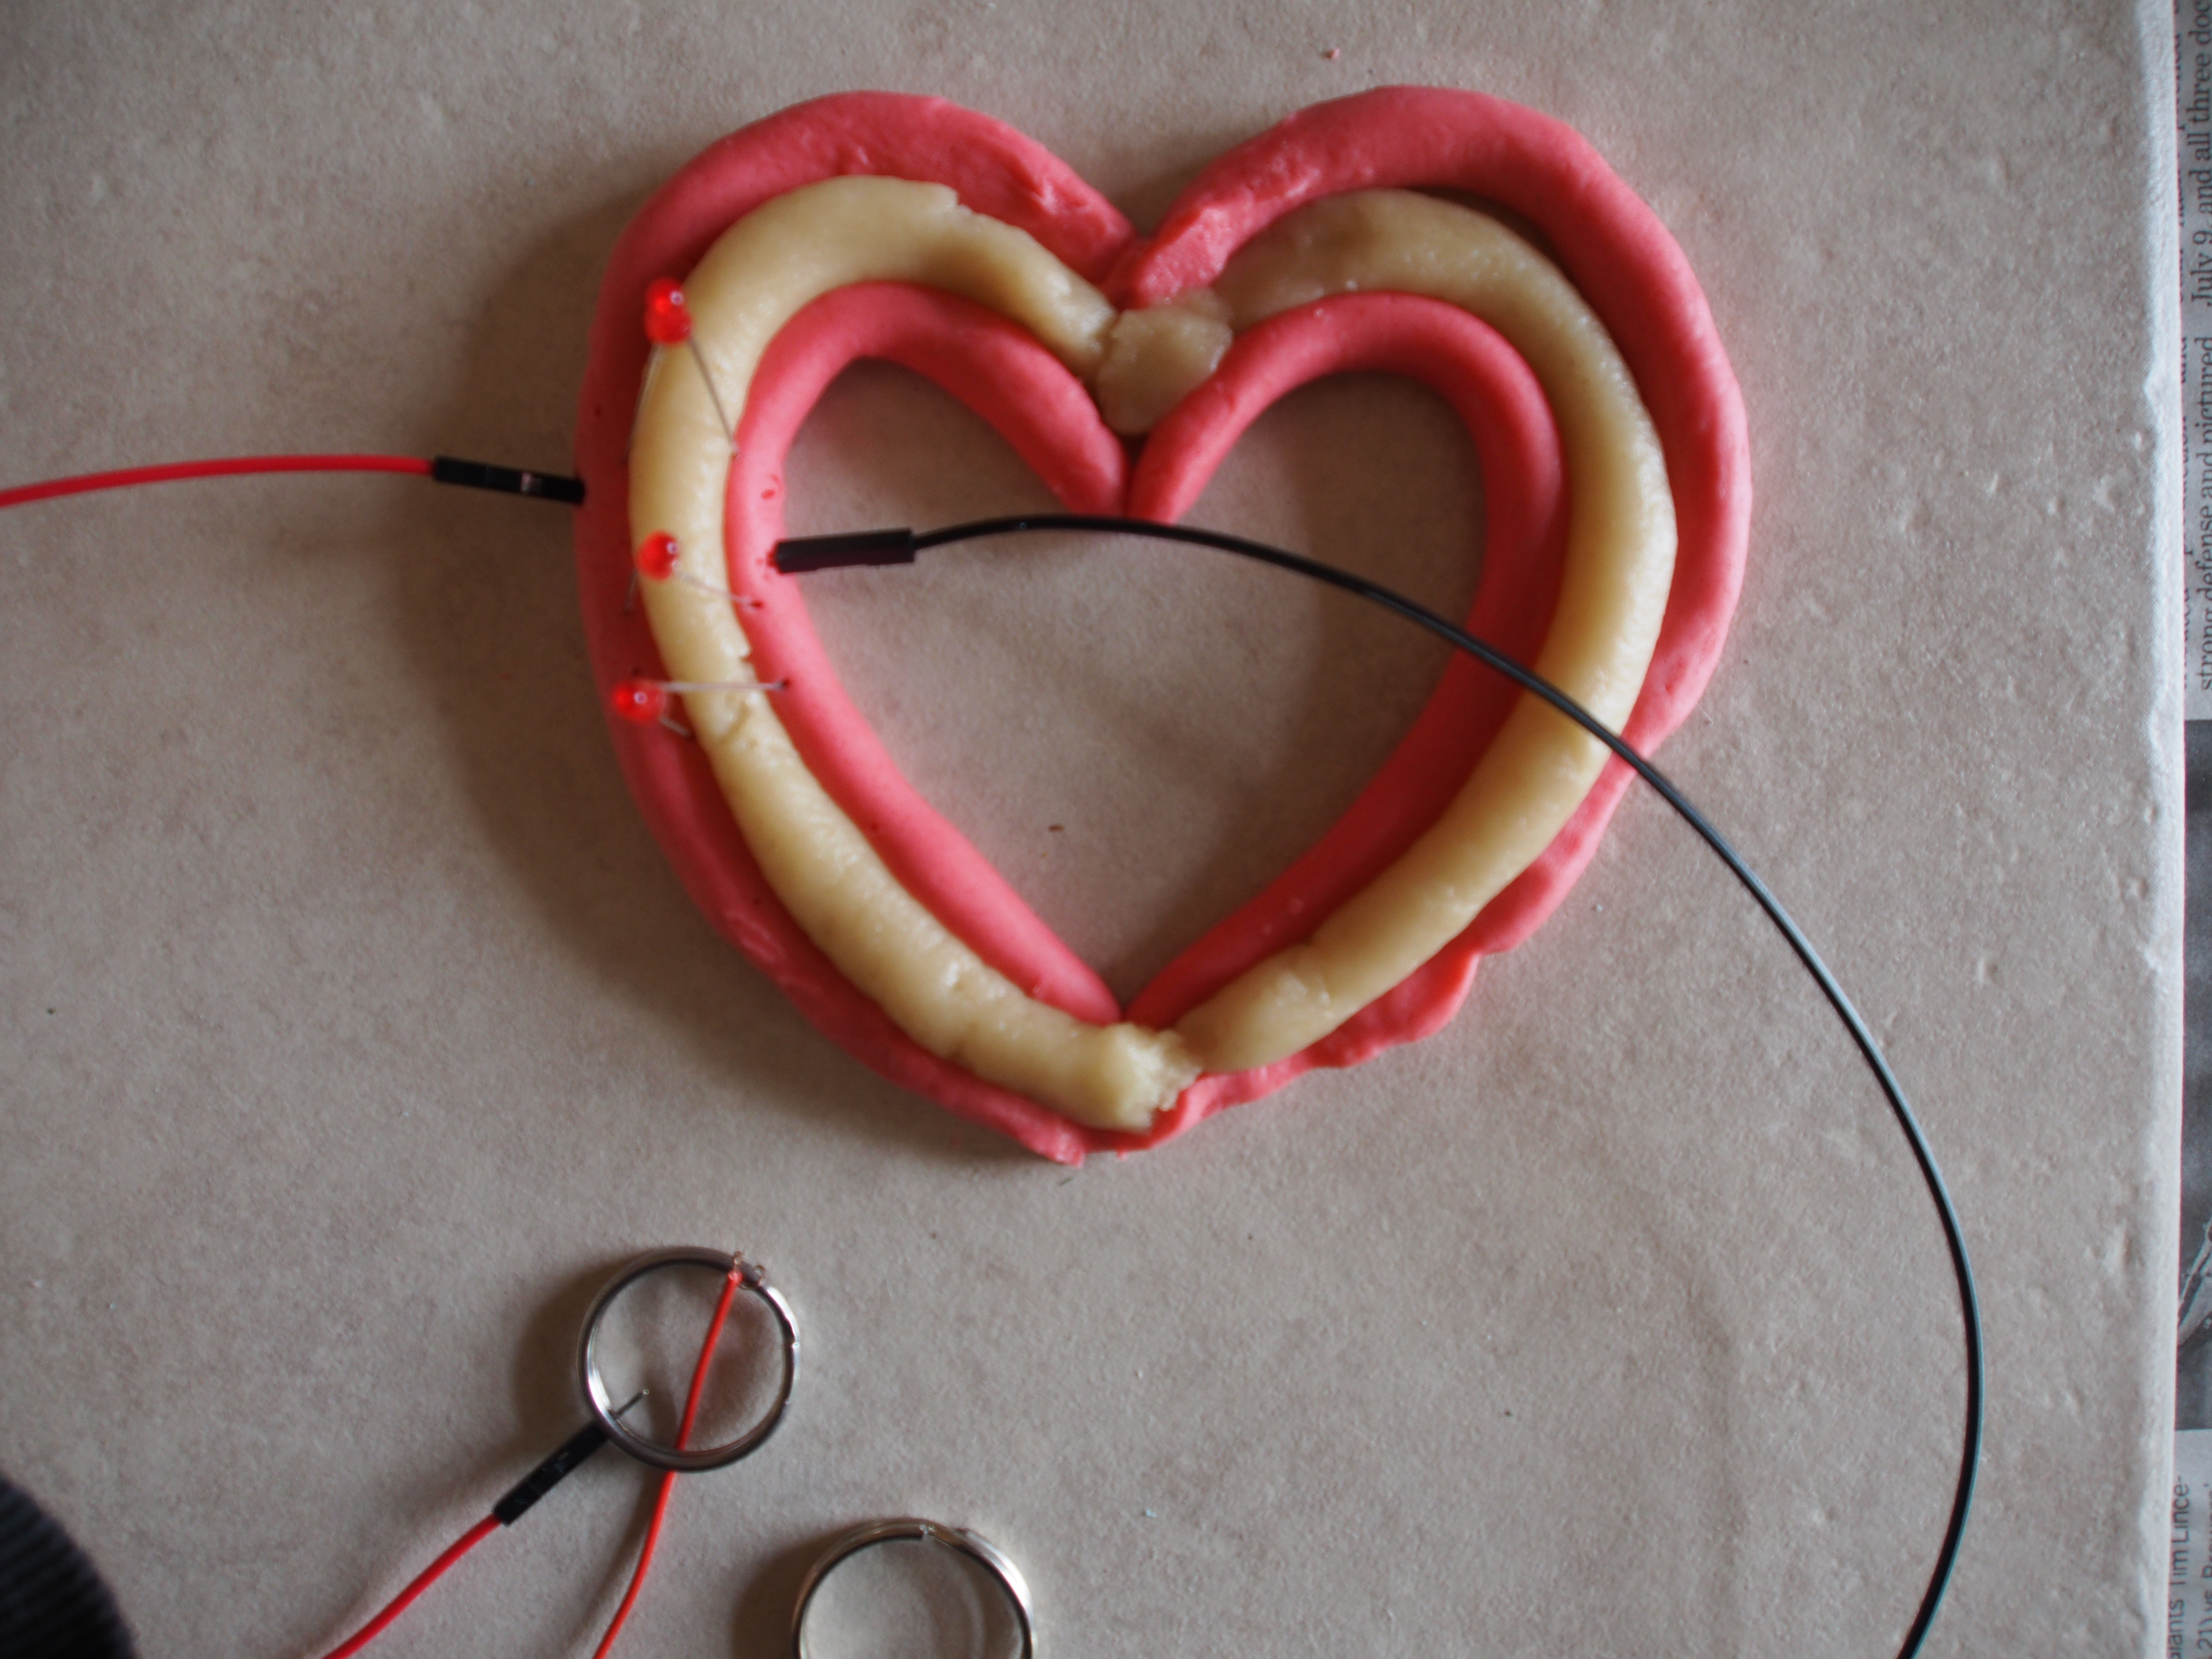
Complex Heart Activity #3
What you need:
1 color of conductive dough(any color, up to you what you want)
white insulating dough
1-5 LEDs, depending on preference on how you want to light up your heart outline

Slide 2
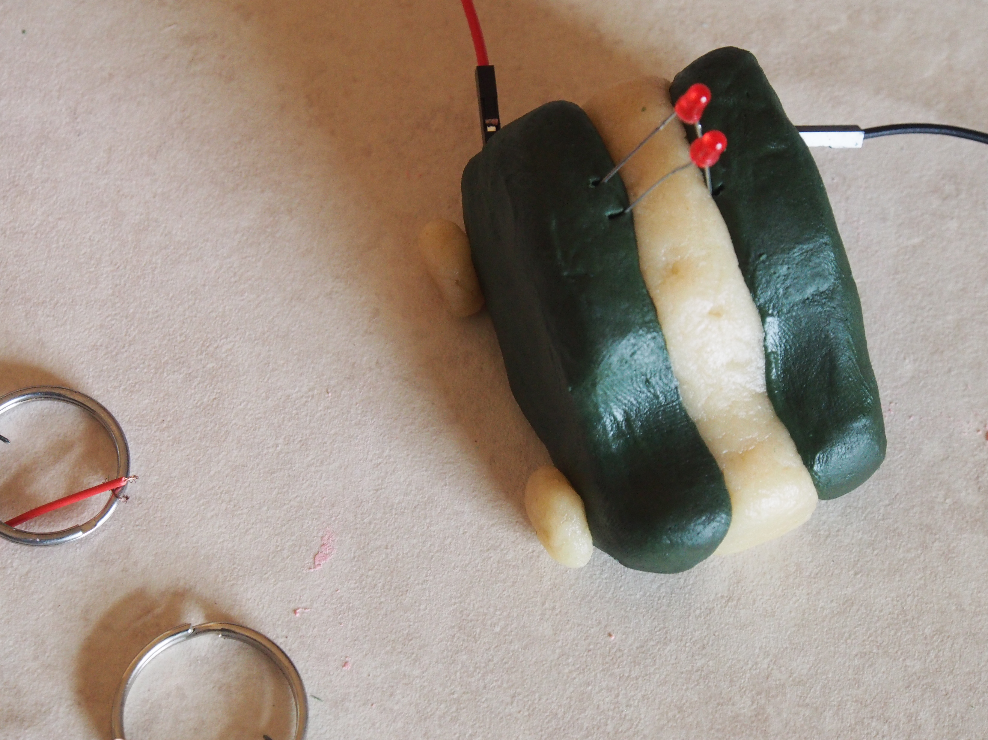

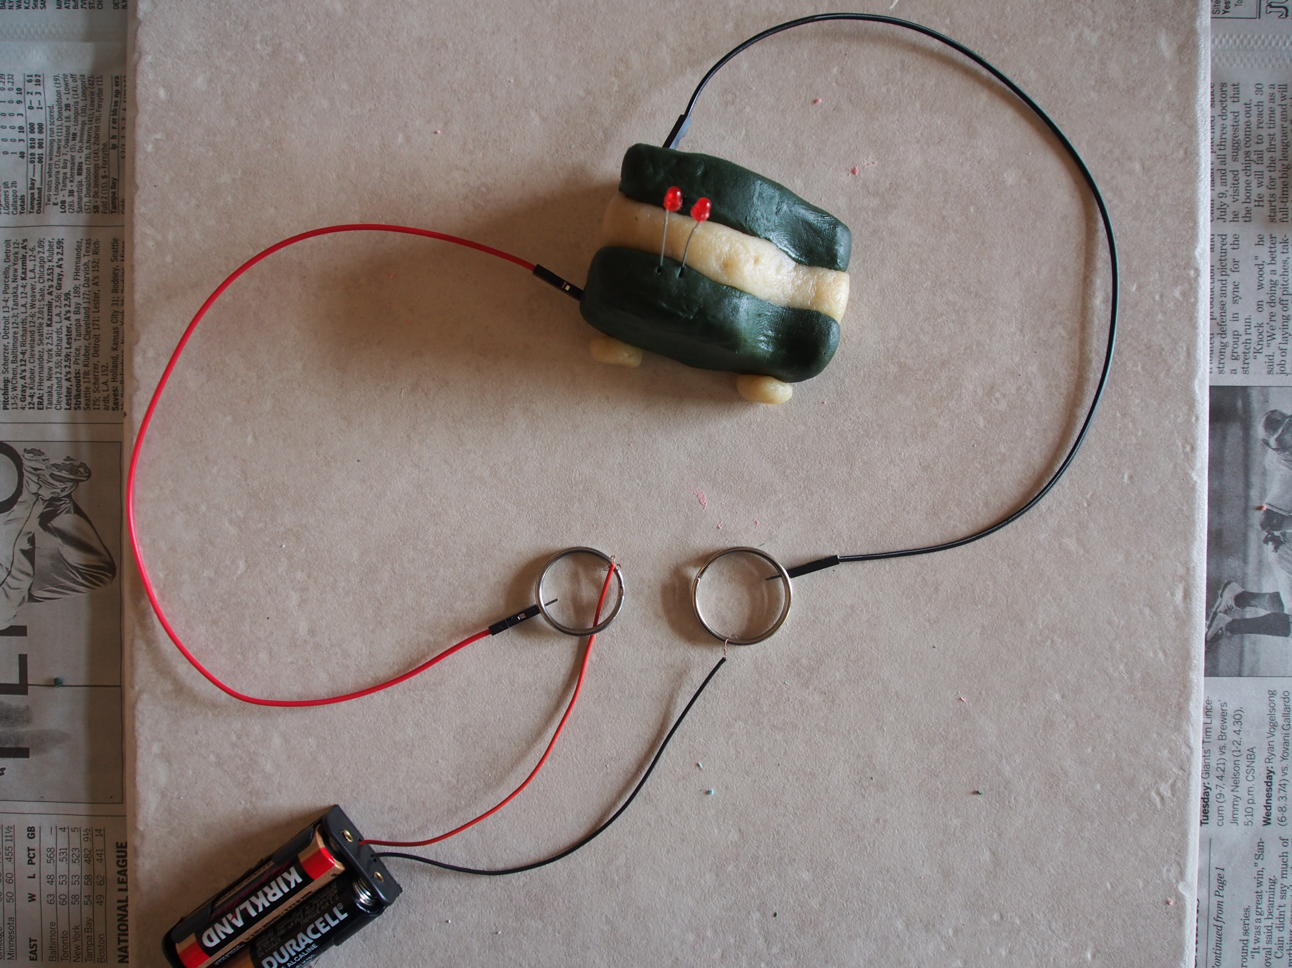
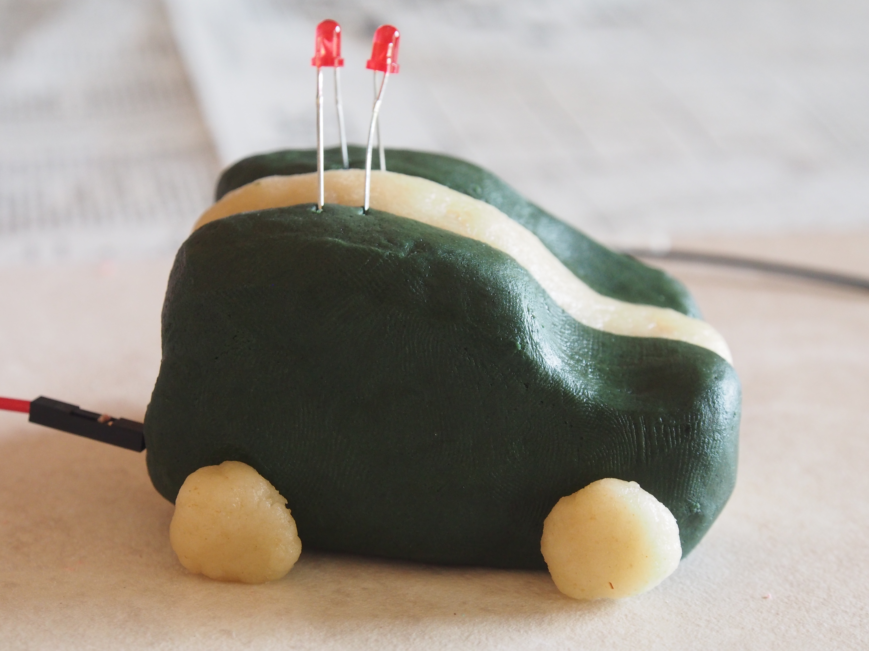
Police Car Activity #4
What you need:
black conductive dough
white insulating dough
2 red LEDs, for the light on top of the police car

Slide 3
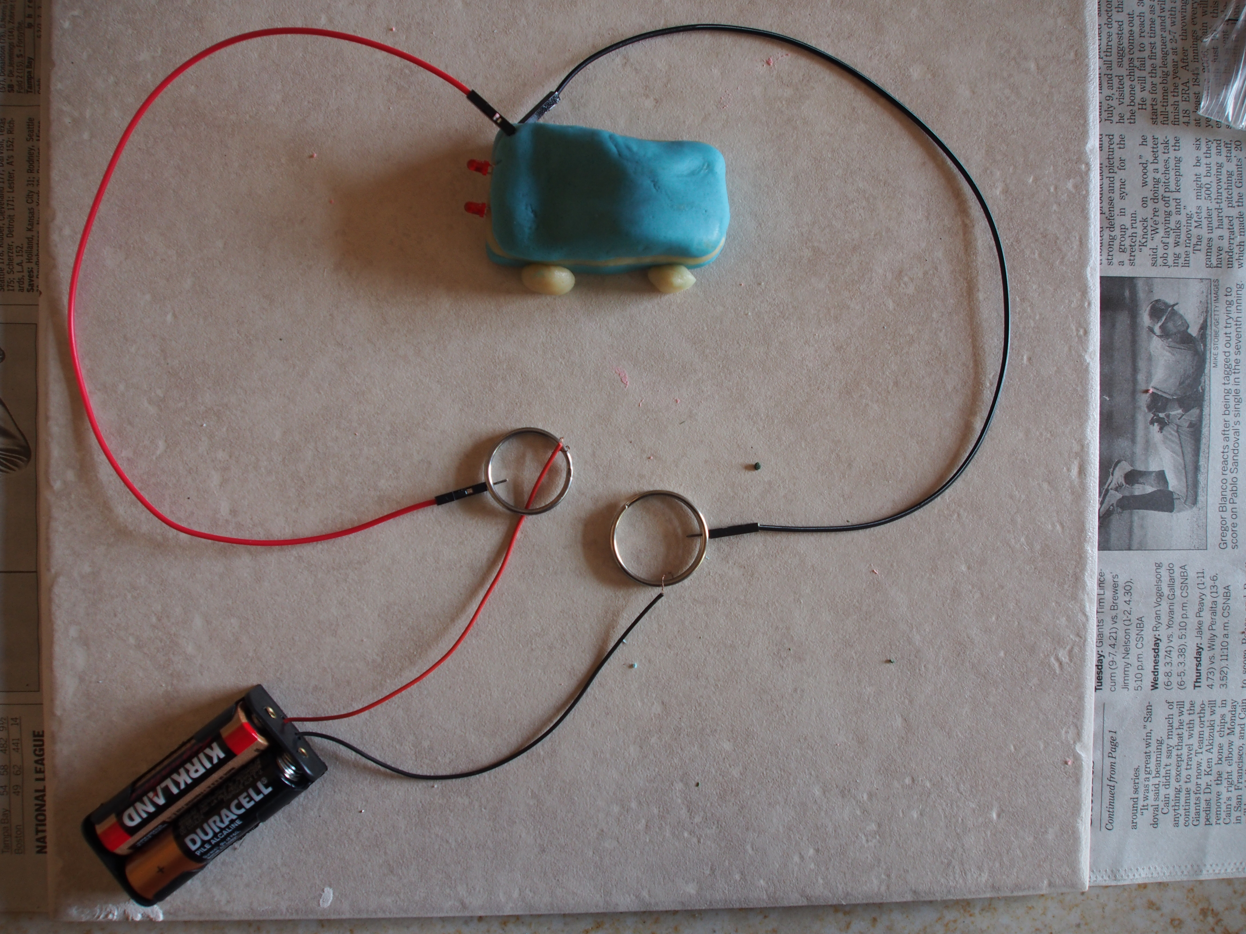
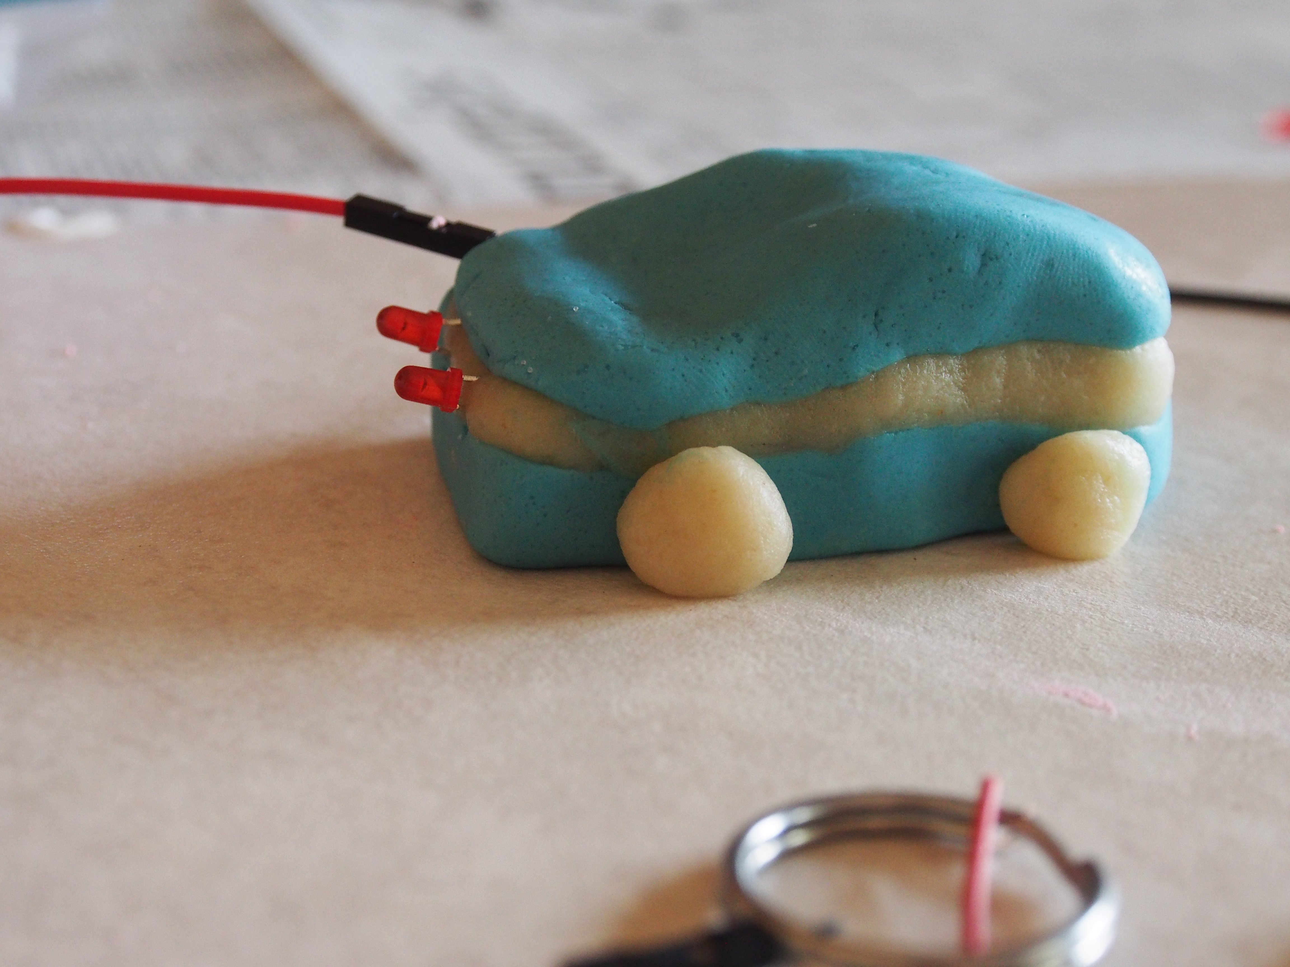
Car with Front Headlight Activity #5
What you need:
blue conductive dough
white insulating dough
2 LEDs for the headlights in the front hood of the car

Slide 4
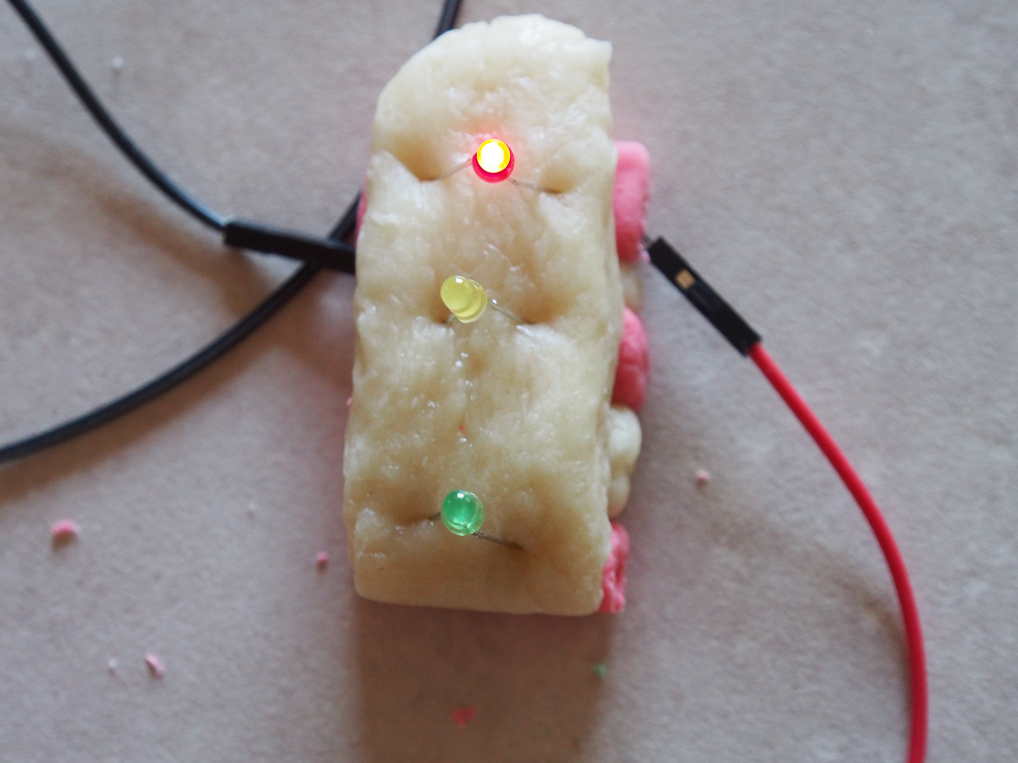
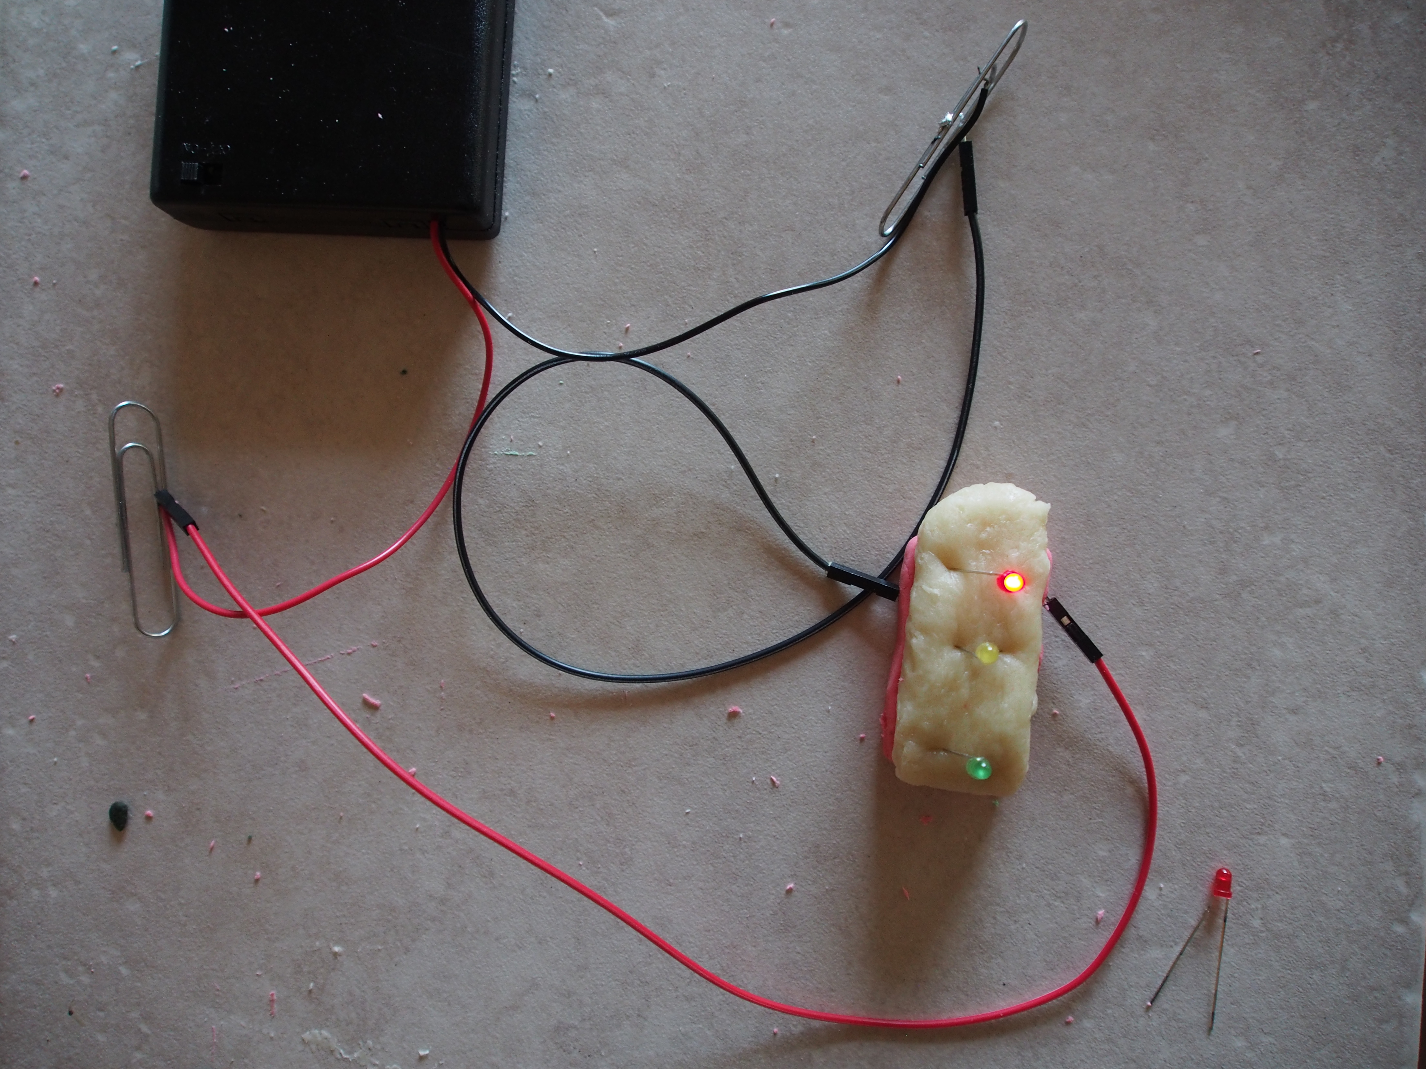
Traffic Light Activity #6
What you need:
black conductive dough
white insulating dough
3 LEDs, one red, one yellow, and one green
Notes:
Parallel Circuit- only 1 LED is lighting at a time and only 1 closed loop.

Slide 5
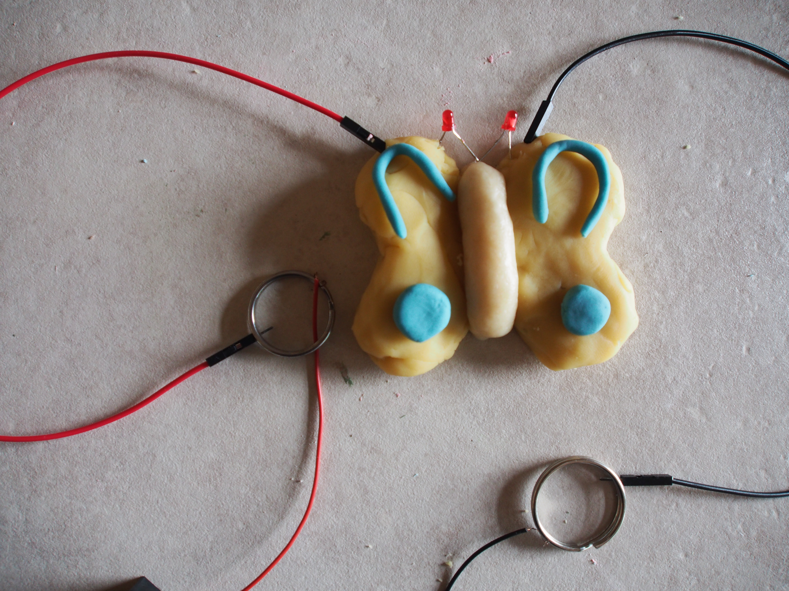
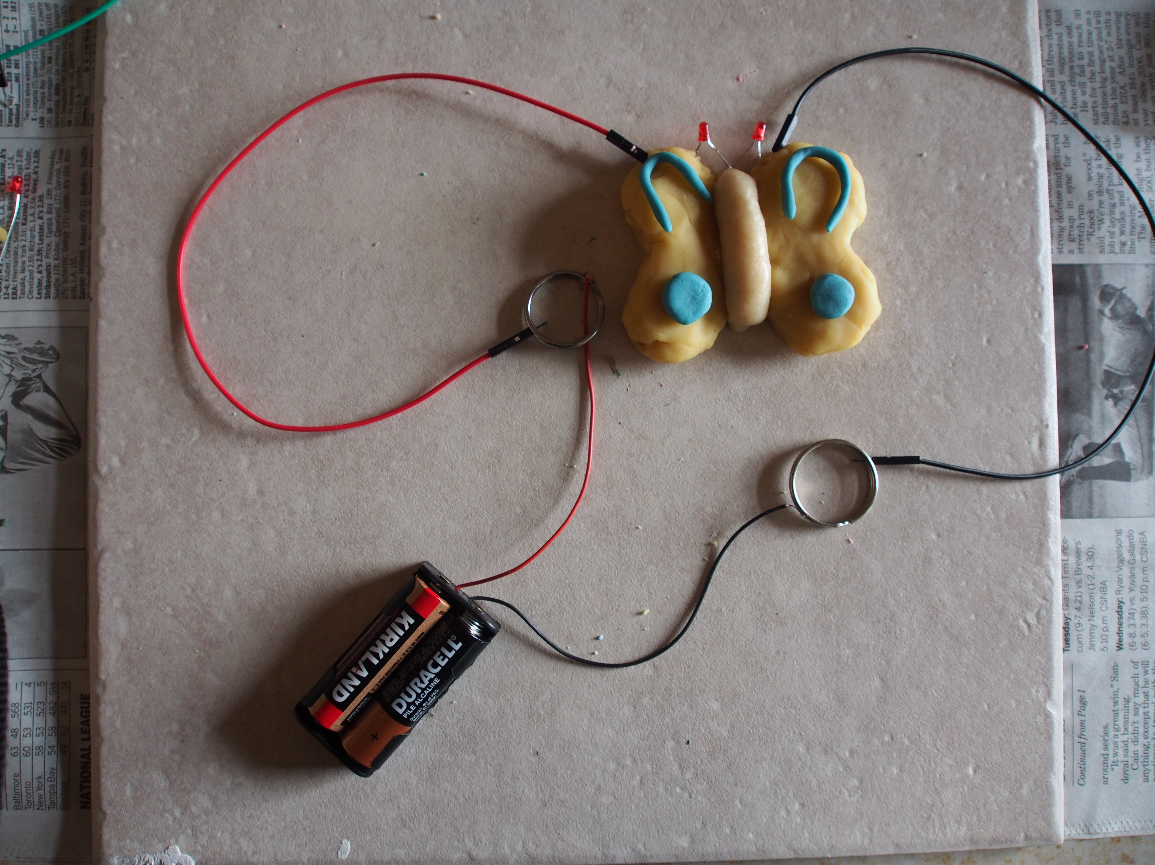
Butterfly Activity #7
What you need:
blue conductive dough
yellow conductive dough
white insulating dough
2 LEDs
Notes:
Parallel

Slide 6
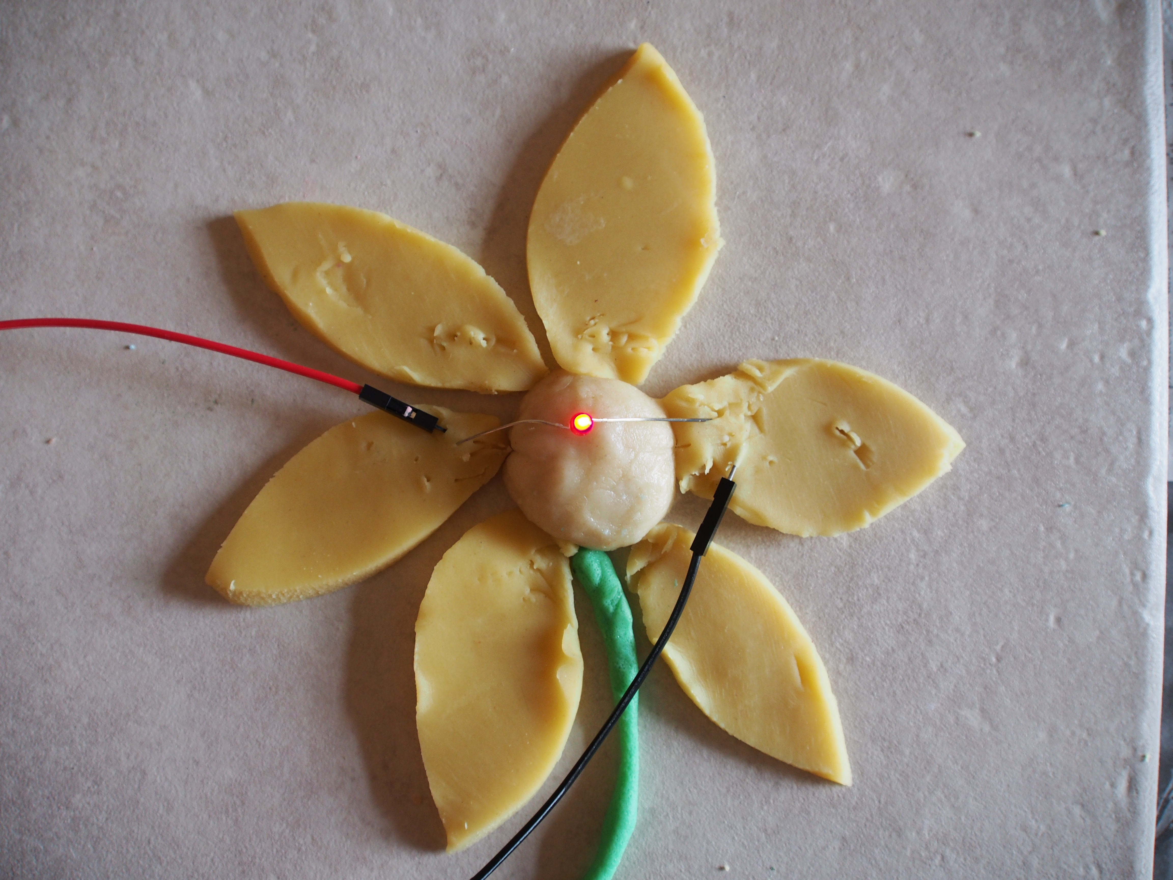
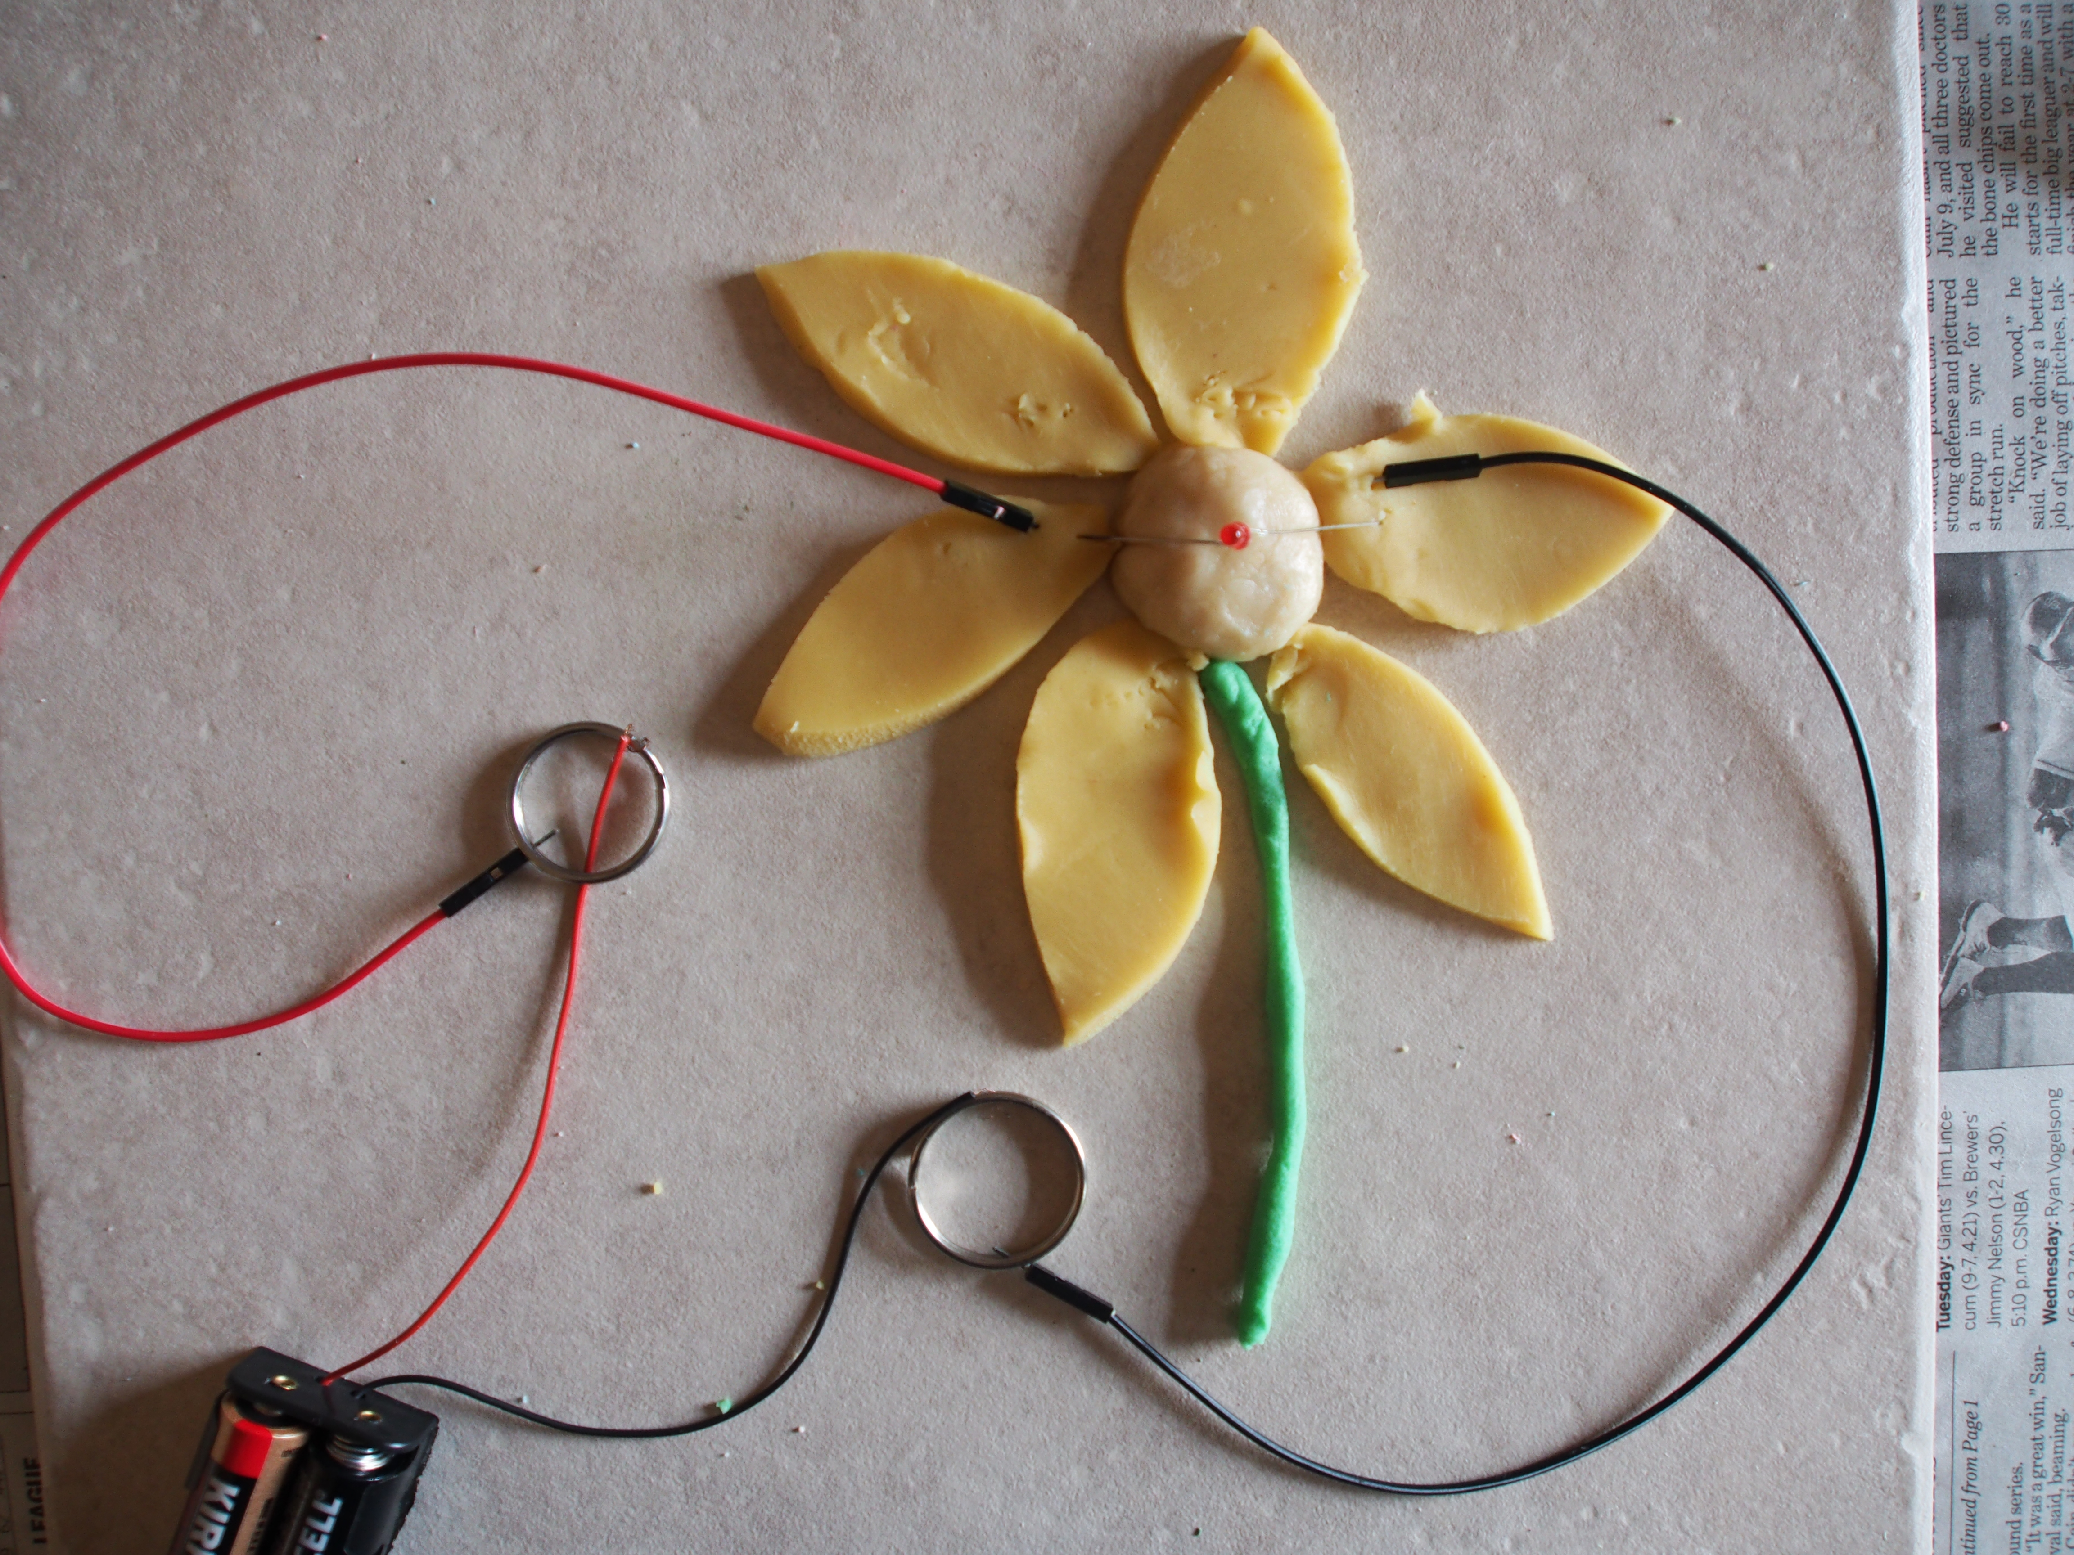
Flower Activity #8
What you need:
green conductive dough
yellow conductive dough
white insulating dough
1-4 LEDs

Slide 7
